Slide 1

Introduction to Computing and Programming in Python™: A Multimedia Approach
Fourth Edition
Chapter 13
Making Text for the Web
Slides in this presentation contain hyperlinks. JAWS users should be able to get a list of links by using INSERT+F7
Copyright © 2016, 2013, 2010 Pearson Education, Inc. All Rights Reserved
Notes:
If this PowerPoint presentation contains mathematical equations, you may need to check that your computer has the following installed:
1) MathType Plugin
2) Math Player (free versions available)
3) NVDA Reader (free versions available)
Thanks to John Sanders of Suffolk University for contributions to these slides!

Slide 2
Learning Objectives
13.1 To gain some basic skill with H T M L.
13.2 To automatically generate H T M L for input data, like an index page for a directory of images.
13.3 To use databases to generate Web content.
13.4 To use another number base, hexadecimal, for specifying RGB colors.
13.5 To distinguish between X M L and H T M L.
13.6 To explain what S Q L is, and what it has to do with relational databases.
13.7 To create and use subfunctions (utility functions).
13.8 To demonstrate one use for hash tables (dictionaries).

Slide 3
Hypertext Markup Language (H T M L)
H T M L is a kind of S G M L (Standardized general markup language)
S G M L was invented by I B M and others as a way of defining parts of a document Completely apart from how the document was formatted.
H T M L is a simpler form of S G M L, but with a similar goal.
The original idea of H T M L was to define the parts of the document and their relation to one another without defining what it was supposed to look like.
The look of the document would be decided by the client (browser) and its limitations.
For example, a document would look different on a P D A than on your screen or on your cellphone.
Or in I E vs. Netscape vs. Opera vs….

Slide 4
Evolution of H T M L
But with the explosive growth of the Web, H T M L has become much more.
Now, people want to control the look-and-feel of the page down to the pixels and fonts.
Plus, we want to grab information more easily out of Web pages.
Leading to X M L, the eXtensible Markup Language.
X M L allows for new kinds of markup languages (that, say, explicitly identify prices or stock ticker codes) for business purposes.

Slide 5
Three Kinds of H T M L Languages
Original H T M L: Simple, what the earliest browsers understood.
CSS, Cascading Style Sheets
Ways of defining more of the formatting instructions than H T M L allowed.
X H T M L: H T M L re-defined in terms of X M L.
A little more complicated to use, but more standardized, more flexible, more powerful.
It’s the future of where the Web is going.

Slide 6
When Use Each?
Bigger sites should use X H T M L and C S S
X H T M L enforces accessibility requirements so that your documents can be read by Braille browsers and audio browsers.
H T M L is easiest for simple websites.
For most of this lecture, we’ll be focusing on X H T M L, but we’ll just use “H T M L” generically.
We’re not going to get into much of the formatting side of X H T M L nor C S S—detailed, and isn't the same on all browsers.

Slide 7
Markup Means Adding Tags
A markup language adds tags to regular text to identify its parts.
A tag in H T M L is enclosed by
Most tags have a starting tag and an ending tag.
A paragraph is identified by a
at its start and a
at its end.
A heading is identified by a
at its start and a
at its end.

Slide 8
H T M L is Just Text in a File
We enter our text and our tags in just a plain ole ordinary text file.
Use an extension of “.html” (“.htm” if your computer only allows three characters) to indicate H T M L.
J E S works just fine for editing and saving H T M L files.
Just don’t try to load them!

Slide 9
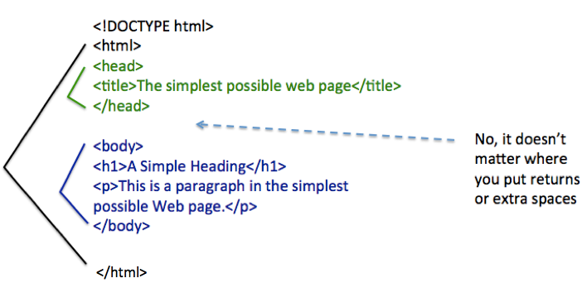
Parts of a Web Page (1 of 2)

Slide 10
Parts of a Web Page (2 of 2)
You start with a DOCTYPE
It tells browsers what kind of language you’re using below.
The whole document is enclosed in
tags.
The heading is enclosed with
That’s where you put the
The body is enclosed with
That’s where you put
headings and
paragraphs.

Slide 11
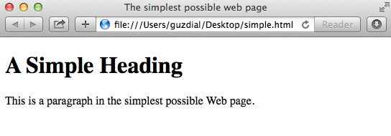
What It Looks Like in Webkit

Slide 12
Is This a Web Page?
Of course, it is!
The only difference between this page and one on the Web is that the one on the Web (a) has been uploaded to a Web server and (b) placed in a directory that the Web server can access.
See the Networking lecture

Slide 13
What If You Forget the DOCTYPE? or an Ending Tag?
It’ll probably work.
Browsers have developed to deal with all kinds of weird H T M L.
But if the browser has to guess, then it may guess wrong
That is, not what you expected or meant.
Which is when your document may look different on different browsers.

Slide 14
Other Things in There
We’re simplifying these tags a bit.
More can go in the
Javascript
References to documents like cascading style sheets
The
tag can also set colors.
These are actually setting R G B values!

Slide 15
A Tiny Tutorial on Hexadecimal
You know decimal numbers (base 10)
0,1,2,3,4,5,6,7,8,9,10,11,12,13,14,15,16
You’ve heard a little about binary (base 2)
0000,0001,0010,0011,0100,0101…
Hexadecimal is base 16
0,1,2,3,4,5,6,7,8,9,A,B,C,D,E,F,10 (16 base 10)

Slide 16
Hexadecimal Colors in H T M L
#FF0000 is Red
255 for red (F F), 0 for green, 0 for blue
#0000FF is Blue
0 for red, 0 for green, 255 for blue
#000000 is black
0 for red, 0 for green, 0 for blue
#FFFFFF is white
255 for red, 255 for green, 255 for blue

Slide 17
Emphasizing Your Text
There are six levels of headings defined in H T M L.
Lower numbers are larger, more prominent.
Styles

Slide 18
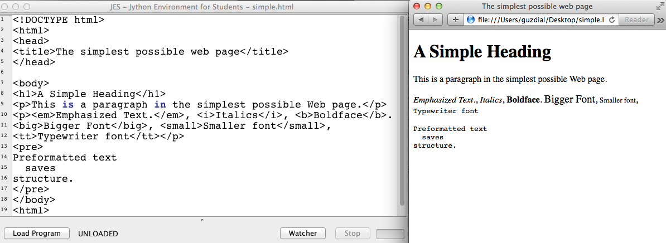
Examples of Styles

Slide 19
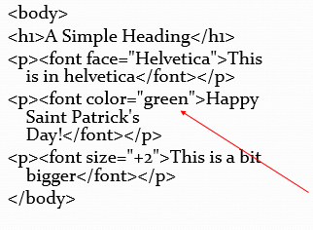
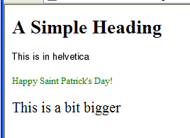
Finer control: Computer code reads, left angle bracket font right angle bracket
Can control type face, color, or size
Can also use hexadecimal R G B specification here.

Slide 20
Breaking a Line
Line breaks are part of formatting, not content, so they were added grudgingly to H T M L.
Line breaks don’t have text within them, so they include the ending “\” within themselves.

Slide 21
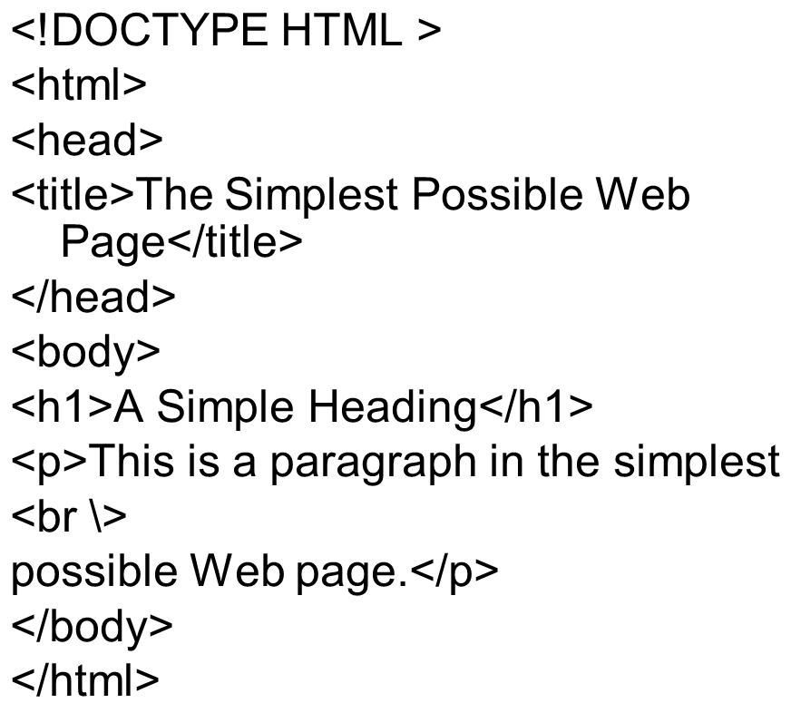
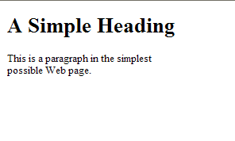
Adding a Break

Slide 22
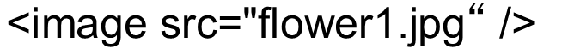
Adding an Image
Like break, it’s a standalone tag.
What goes inside the quotes is the path to the image.
If it’s in the same directory, don’t need to specify the path.
If it’s in a subdirectory, you need to specify the subdirectory and the base name.
You can walk a directory by going up to a parent directory with “..”
You can also provide a complete U R L to an image anywhere on the Web.

Slide 23
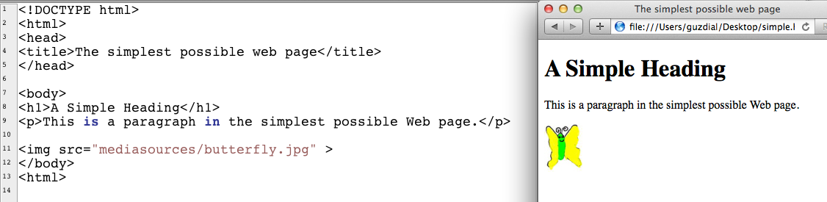
An Example Image Tag Use
Notes:
This is sitting in my main directory, above mediasources
This is sitting in my main directory, above mediasources

Slide 24
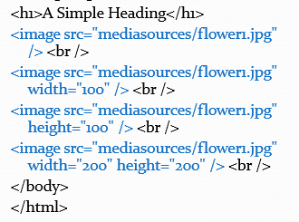
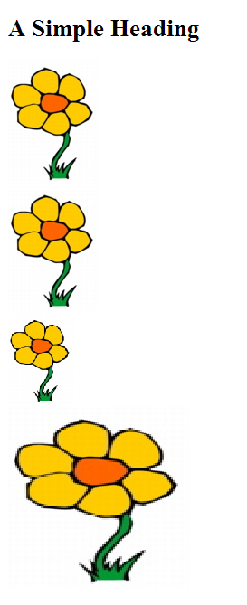
Parameters to Image Tags
You can specify width and height in image tags.

Slide 25
Alt in Images
Some browsers (like audio or Braille) can’t show images.
You can include alternative text to be displayed instead of the image in those cases.

Slide 26
Other Options in Image Tags
align=“left” or align=“right” to float an image
hspace=“10” or vspace=“10” to add 10 pixels to left and right, or top and bottom
align=“texttop” will align with top of corresponding text.
Try these out!

Slide 27
Creating Links
Links have two main parts to them:
A destination U R L.
Something to be clicked on to go to the destination.
The link tag is “a” for “anchor”

Slide 28
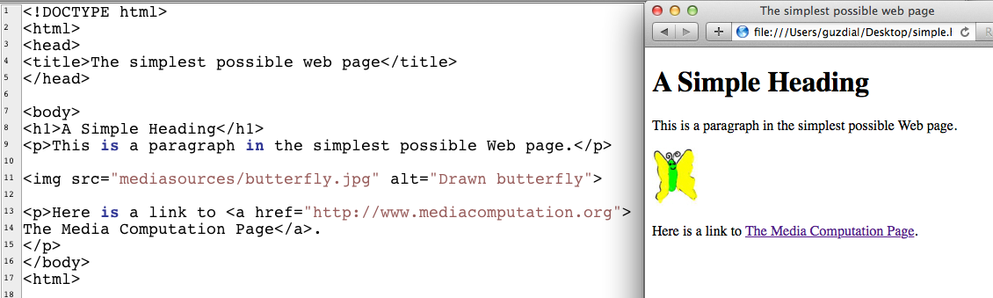
What It Looks Like (1 of 2)

Slide 29
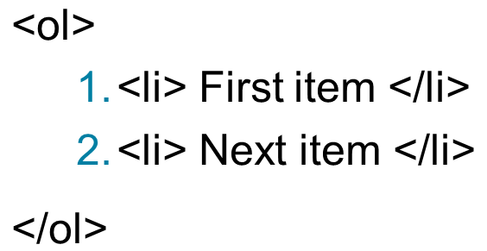
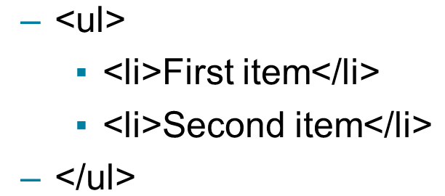
Lists
Ordered lists (numbered)
Unordered lists (bulleted)

Slide 30
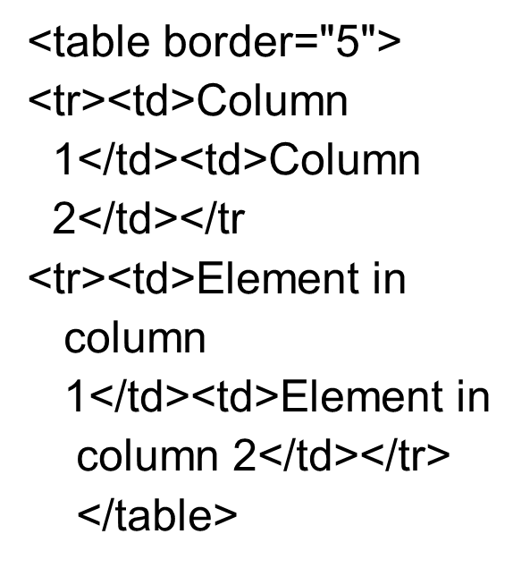
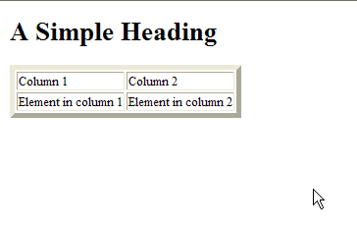
Tables

Slide 31
There is Lots More to H T M L
Frames
Can have subwindows within a window with different H T M L content.
Anchors can have target frames.
Divisions
Horizontal rules
With different sizes, colors, shading, etc.
Applets, Javascript, etc.

Slide 32
Best Way to Learn H T M L: Look at Pages!
View source all the time, especially when there’s something new and cool that you’ve never seen before.
There are lots of good on-line tutorials.
There are many good books.

Slide 33
H T M L is not a Programming Language
Using H T M L is called “coding” and it is about getting your codes right.
But it’s not about coding programs.
H T M L has no
Loops
I F s
Variables
Data types
Ability to read and write files
Bottom line: H T M L does not communicate process!

Slide 34
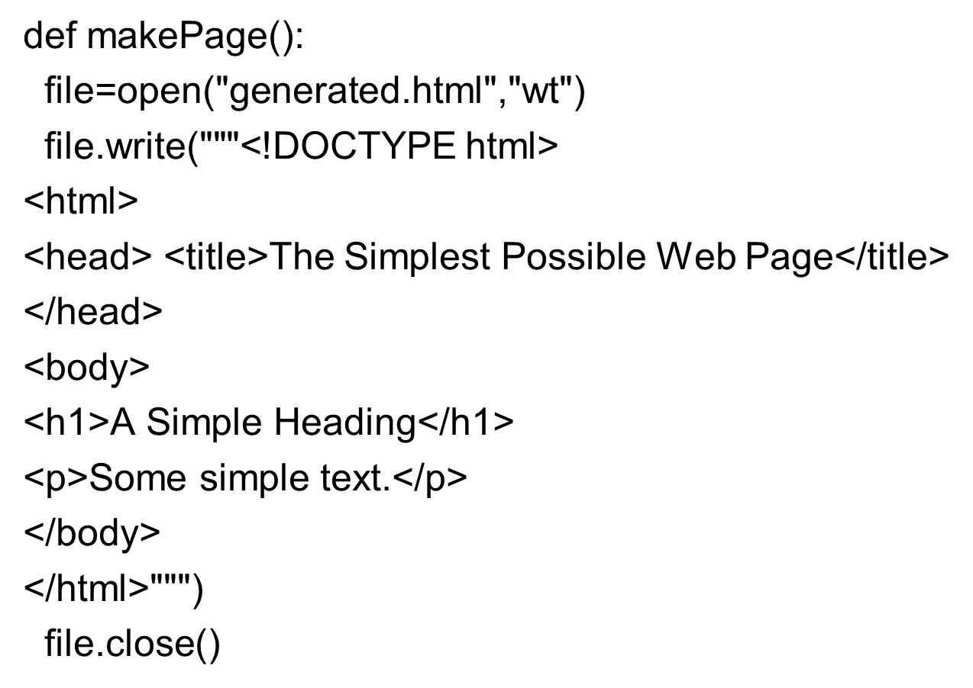
We Can Use Programs to Generate H T M L

Slide 35
How does Amazon and Ebay work?
By generating a catalog as Web pages.
Nobody types up all those product H T M L pages.
Rather, the data is in a database, and there are programs that put the data into a database.

Slide 36
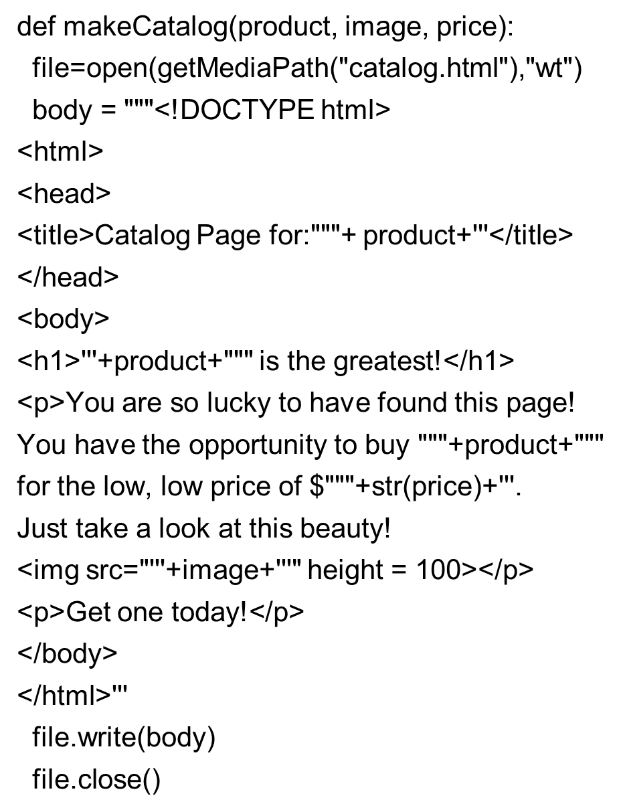
Catalog Page Generator

Slide 37
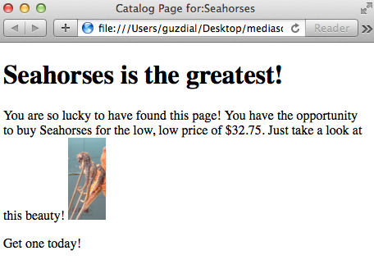
What It Looks Like (2 of 2)

Slide 38
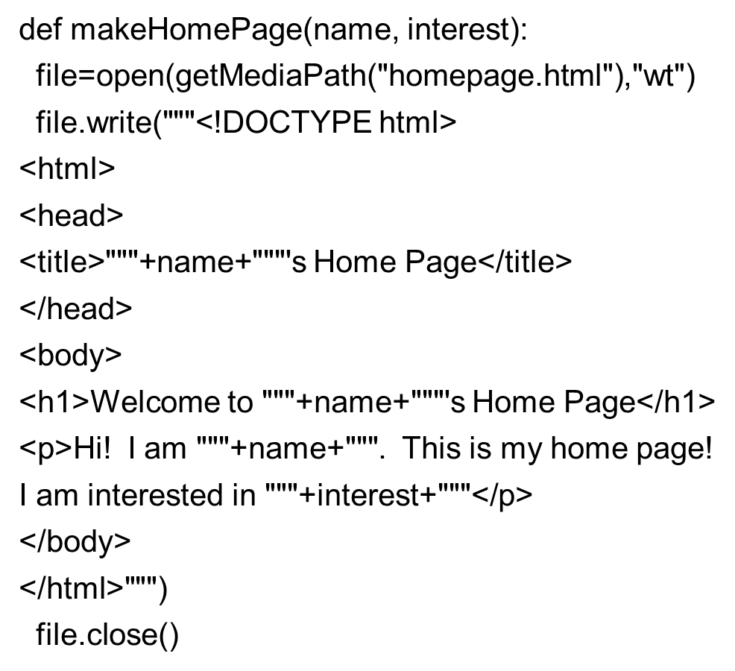
A Homepage Editor

Slide 39
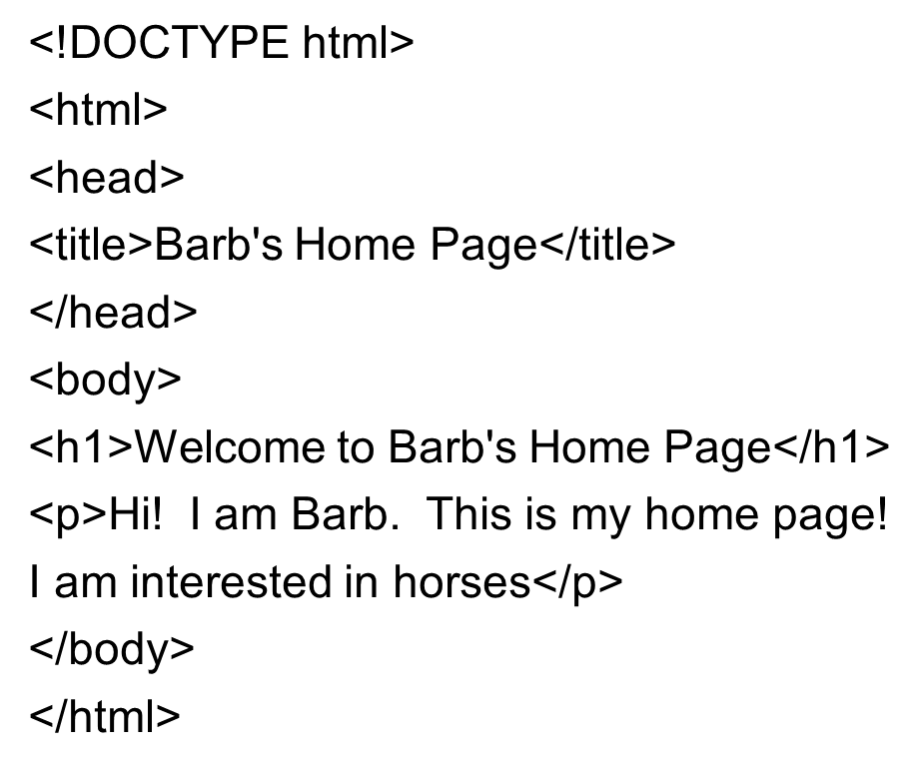
MakeHomePage (“Barb”, “Horses”)

Slide 40
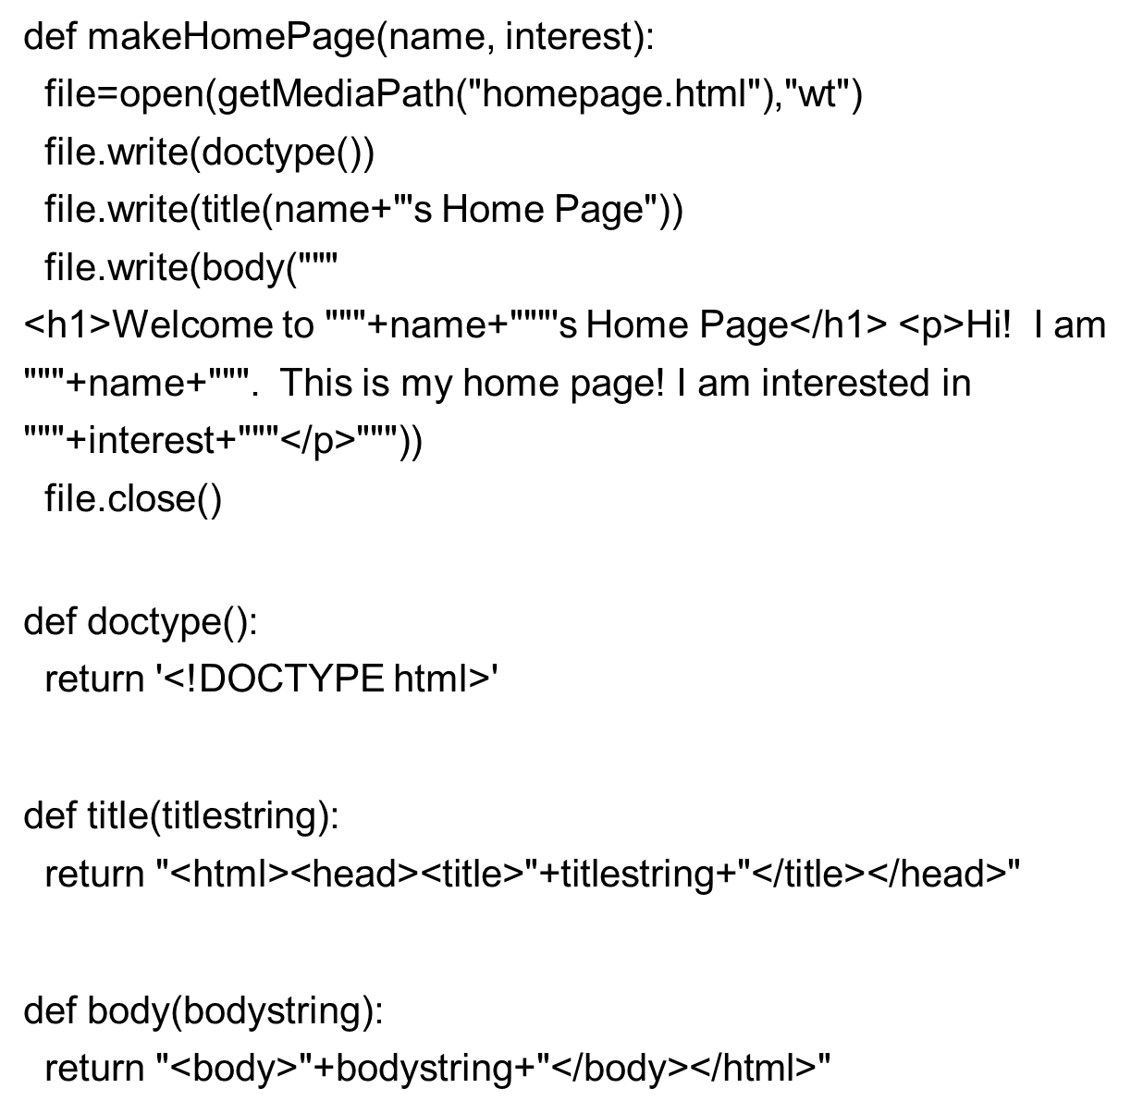
Improved Homepage Generator

Slide 41
Where Can We Get Web Content from? Anywhere We Want!
We’ve learned a lot of ways of generating textual information over the last weeks.
We can use these to create all kinds of Web pages.
Grabbing information out of directories using the o s module
Grabbing information out of other Web pages
Generating random sentences
Generating Web pages from databases

Slide 42
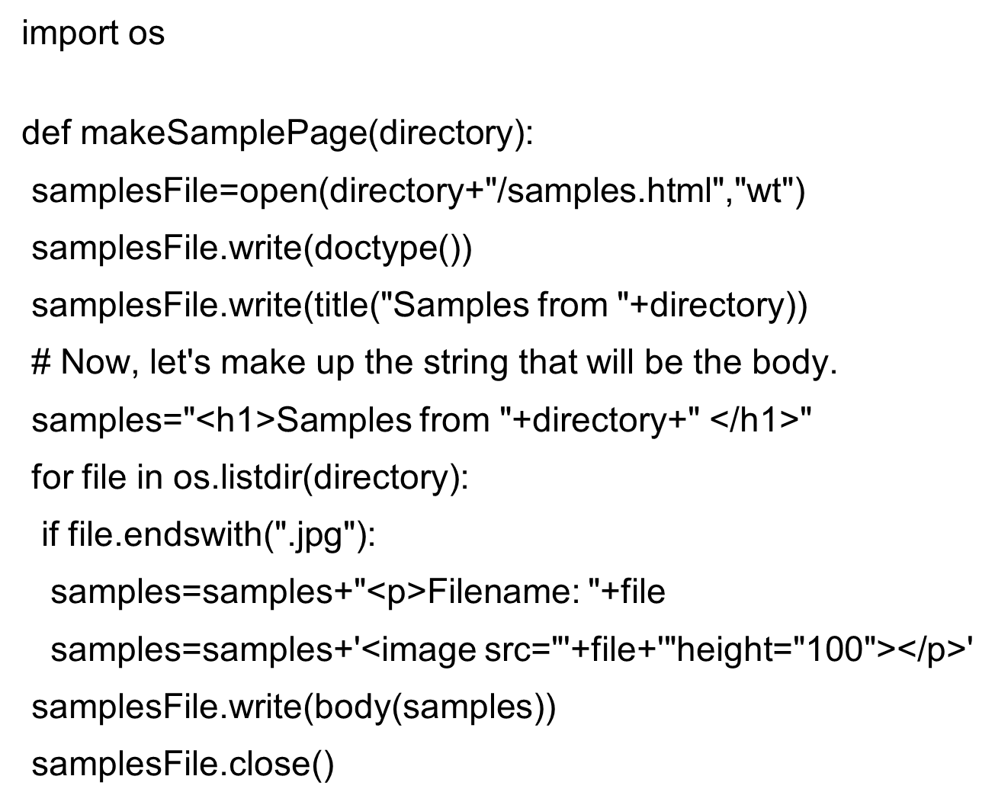
Generating a Samples Page

Slide 43
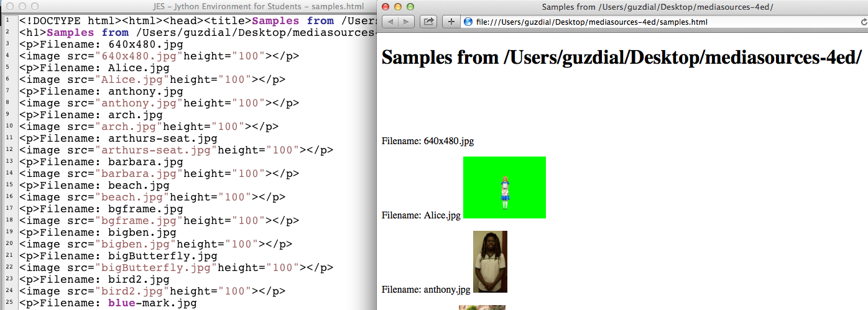
makeSamplePage(getMediaPath(“”))
Notes:
Should do this for mediasources directory as a real test.
Should do this for mediasources directory as a real test.

Slide 44
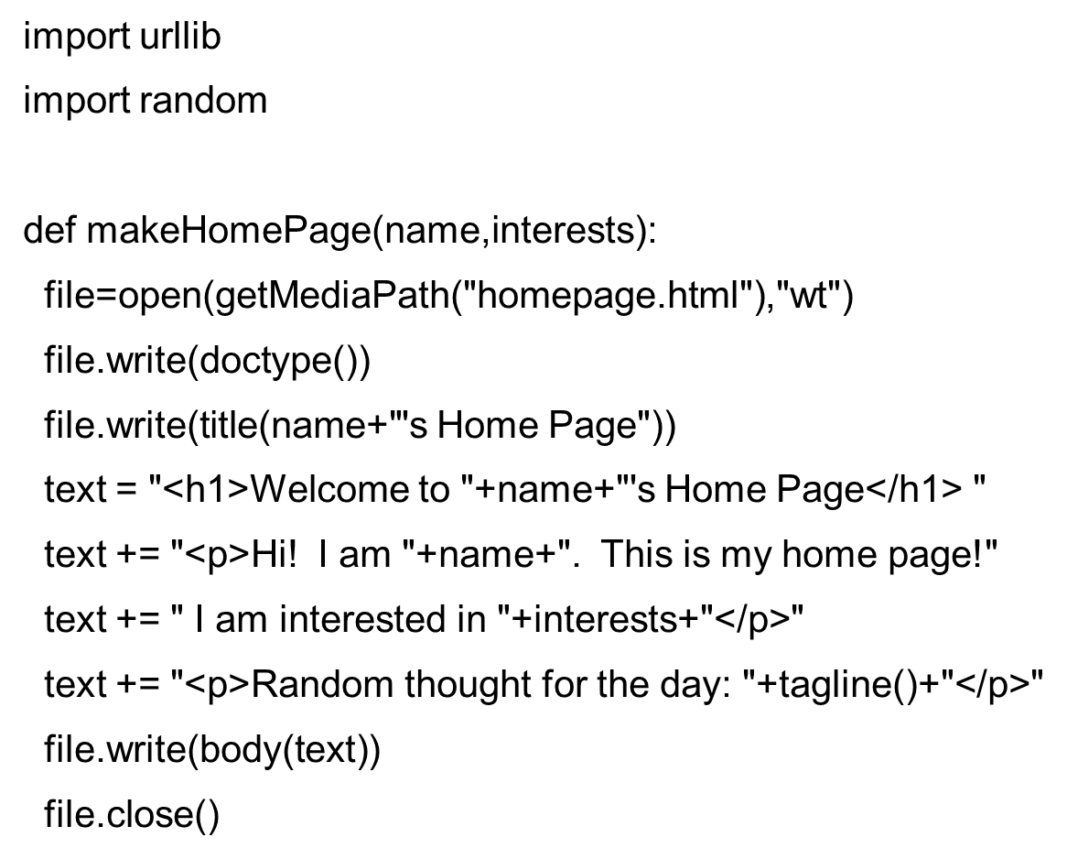
Home Page Generator with Random Tag Lines (1 of 2)

Slide 45
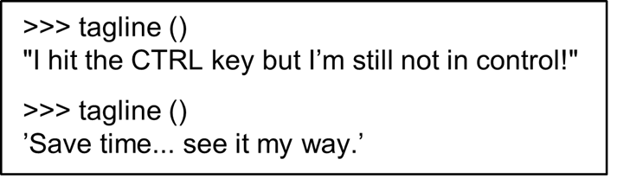
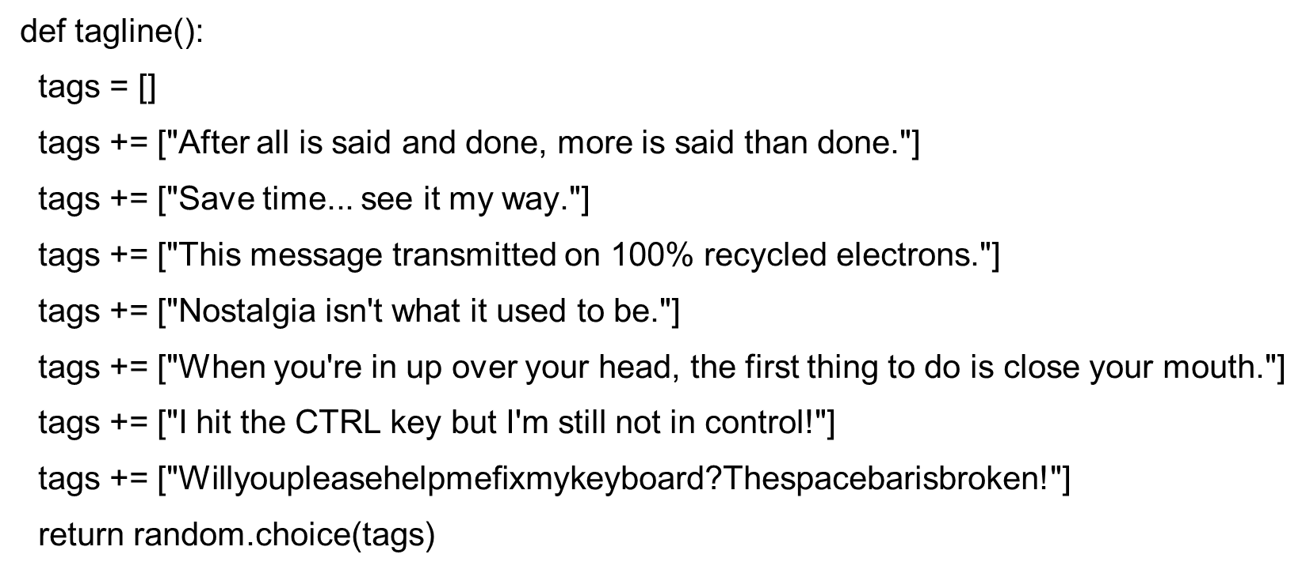
Home Page Generator with Random Tag Lines (2 of 2)

Slide 46
Thought Experiment: Timed Generation
Imagine that you could have this program run every 30 minutes, and immediately copy (F T P) the result up to your Web site.
The temperature would be updated every 30 minutes.
A random sentence would be generated every 30 minutes.
Suggestion: You could do this now!
Most operating systems have some way to do tasks like this (see the Scheduled Tasks control panel in Windows, crontab in Macs and Linux)
You’ve seen how to do F T P automatically.

Slide 47
2nd Thought Experiment: Look How Complicated It’s Getting! (1 of 2)
On the right is all the code for the home page program.
Barely fits on the screen at 8 point font size!
But we only had to worry about a dozen lines of it!
Why?
We used more functions that allowed us to hide away detail that we didn’t want to see anymore!

Slide 48
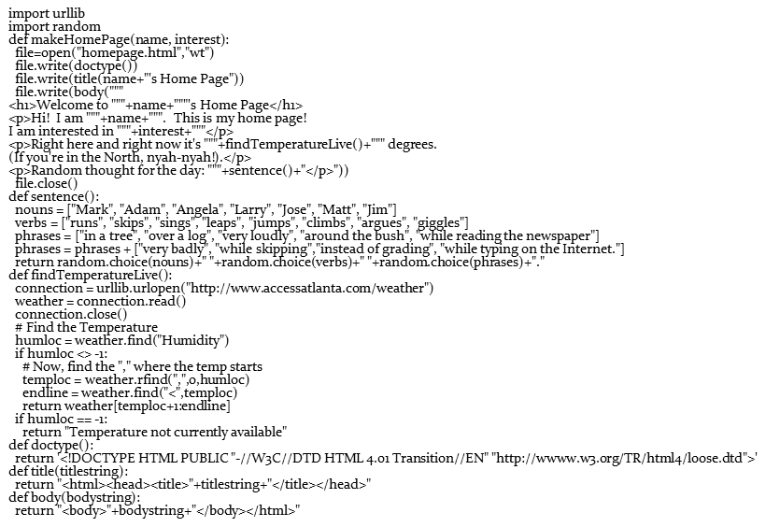
2nd Thought Experiment: Look How Complicated It’s Getting! (2 of 2)

Slide 49
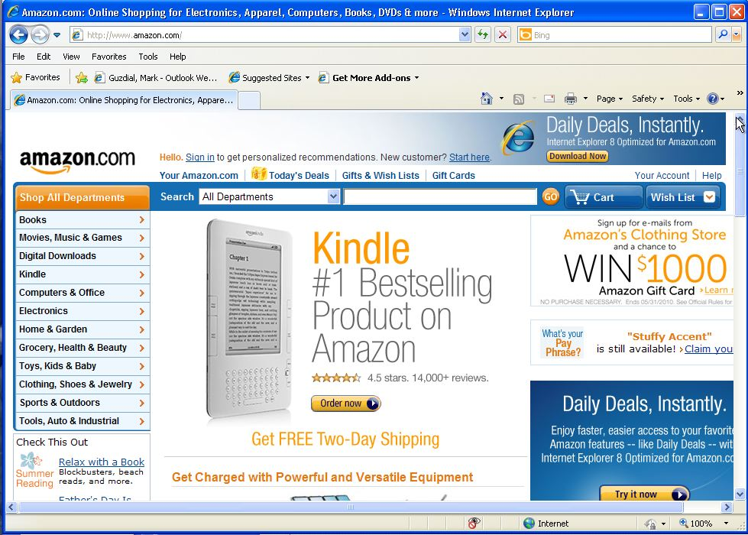
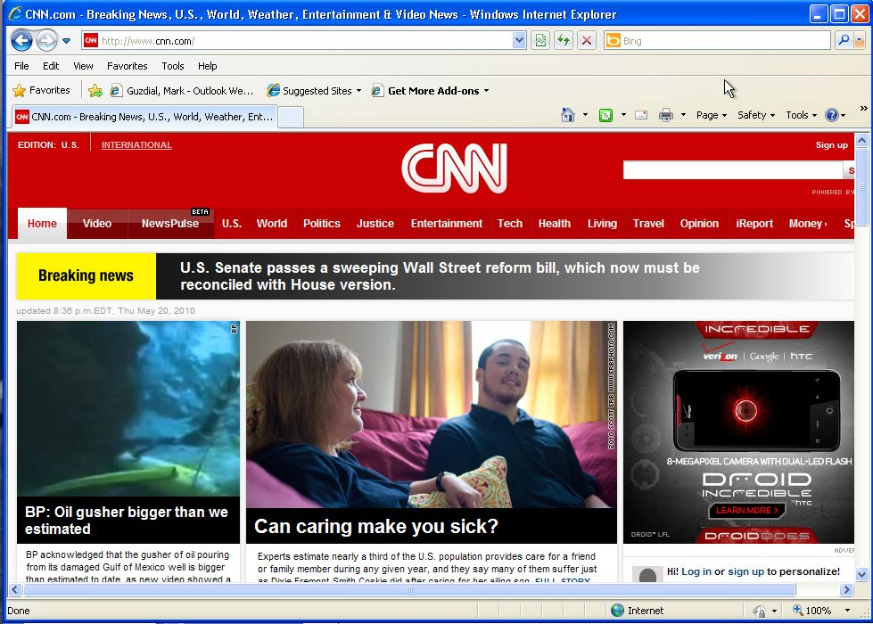
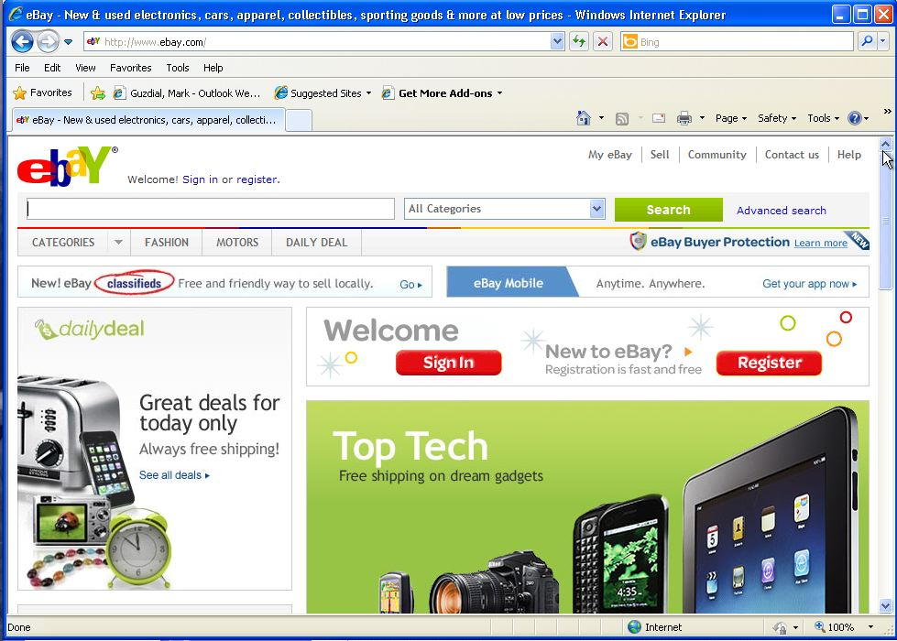
Information Can Come from Anywhere
But it mostly comes from databases.
Every major website generates its web pages from a database.

Slide 50
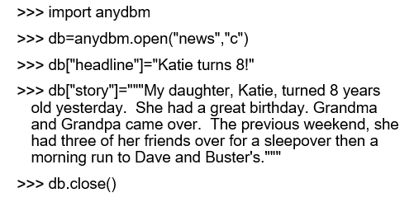
Generating from a Database: Put a Story in the Database

Slide 51
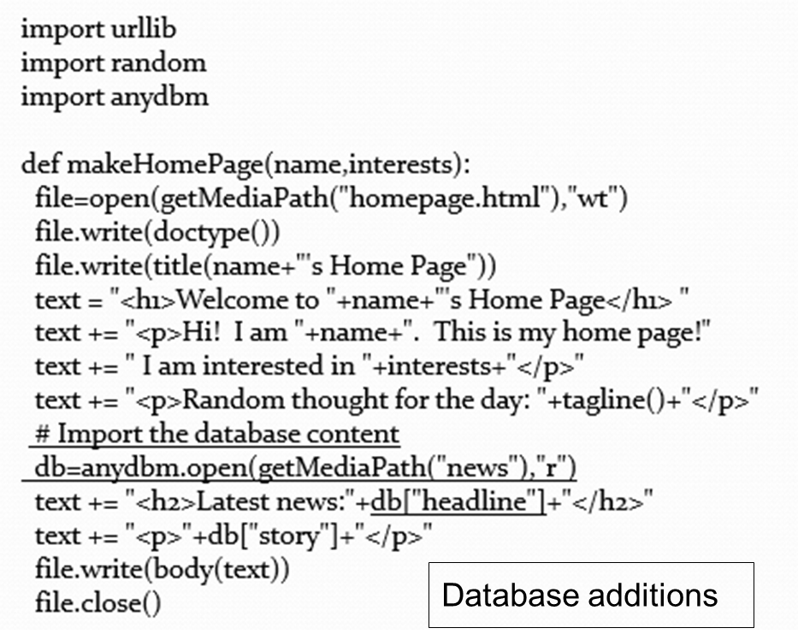
Add News to the Homepage

Slide 52
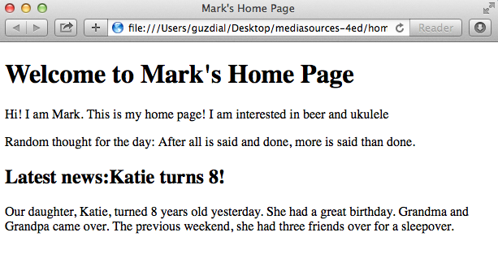
MakeHomePage(“Mark”, “Beer and Ukulele”)

Slide 53
Another Thought Experiment: Database Handled Elsewhere
Imagine that you have a bunch of reporters who are entering stories and headlines into a shared database.
Or just imagine a separate interface to let you enter stories into your own database.
And again, at regular intervals, H T M L pages are generated and uploaded via F T P onto Web servers.
Now you know how C N N.comworks!
Now you know why databases are a big deal for Web developers!

Slide 54
Why is a Database Useful for a Big Web Site?
For C N N.com:
Can have multiple authors and editors creating multiple stories distributed all over a network.
Can pull the content automatically via a program and merge all the stories into one big website
Works similarly for other kinds of large websites
Amazon.com
Where do you think their catalog and review is stored?
EBay.com
Where do you think all those pictures and descriptions and bid information is stored?

Slide 55
Why databases?
Rather: Why not just use files?
Why do we care about using some extra software for storing our bytes?
Databases provide efficient access to data in a standardized mechanism.
Databases are fast.
Databases can be accessed from more than one place in more than one way.
Databases store relations between data

Slide 56
Databases are Fast Because of Indices
Filenames are indexed just by name.
Usually, you care about information that is found by something other than a filename.
For example, you may care about someone’s information identified by last name or by S S N or even birthdate or city/state of residence.

Slide 57
Databases are Standardized
There are many different standard databases.
In the UNIX and open source markets: bsddb, gdbm, My S Q L
In the commercial markets: Microsoft Access, Informix, Oracle, Sybase
Information stored in a standard database can be accessed and manipulated via many different tools and languages.

Slide 58
Databases Store Relations
Recall our list representation of pixels.
It was just a list of five numbers.
Who knew that the first two numbers were x and y positions, and the last three were R G B values?
Only us—it wasn’t recorded anywhere.
Databases can store names for the fields of data
They can store which fields are important (and thus indexed for rapid access), and how fields are related (e.g., that each pixel has three color components, that each student has one transcript)

Slide 59
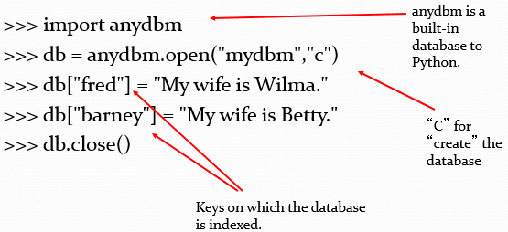
Simplest Databases in Python

Slide 60
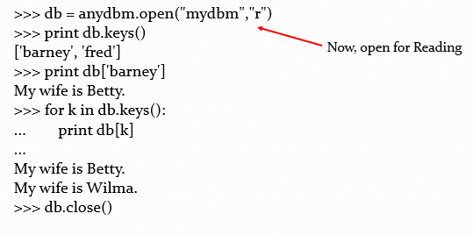
Accessing Our Simple Database

Slide 61
Disadvantages of the Simple Database
Keys and values can only be simple strings.
Can only have a single index.
Can’t index, say, on last name and S S N.
Doesn’t store field names.
There’s no real search or manipulation capability built in other than simply using Python.

Slide 62
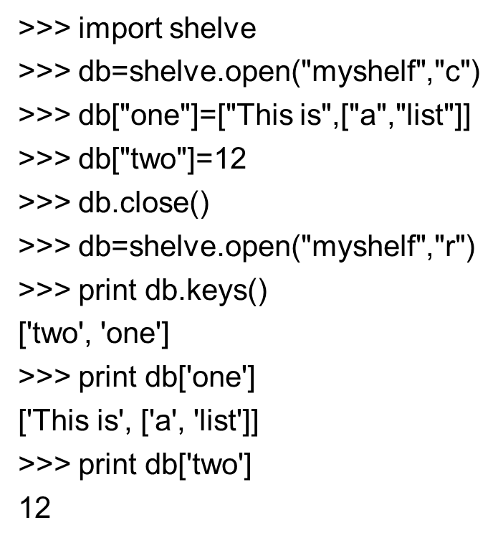
Shelves Store Anything
Can use shelves to store in standardized database formats, but not really useful for Python-specific data.

Slide 63
Well, not Quite Anything
Can we use the shelve module to store and retrieve our media?
It’s not made for data like that.
Lists of pictures didn’t come back from the database the way they were stored.
Lists got mangled: Sub-lists in sub-lists, etc.
Media have many, many more elements than simple databases can handle.

Slide 64
Powerful, Relational Databases
Modern databases are mostly relational
Relational databases store information in tables where columns of information are named and rows of data are assumed to be related.
You work with multiple tables to store complex relationships.

Slide 65
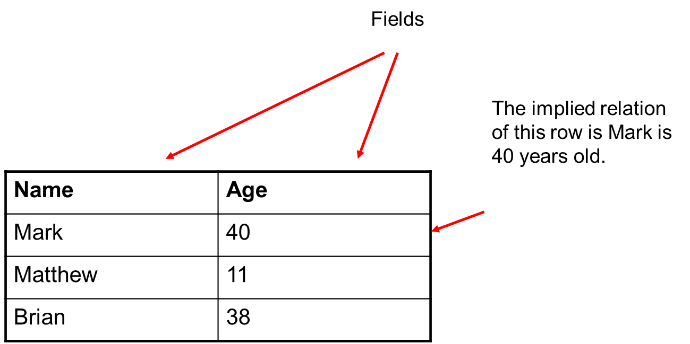
A Simple Table

Slide 66
More Complex Tables
Picture | PictureI D
Class1.jpg | P1
Class2.jpg | P2
StudentName | StudentI D
Katie | S1
Brittany | S2
Carrie | S3
PictureI D | StudentI D
P1 | S1
P1 | S2
P2 | S3

Slide 67
How to Use Complex Tables
What picture is Brittany in?
Look up her I D in the student table
Look up the corresponding PictureI D in the PictureI D-StudentI D table
Look up the picture in the Picture table
Answer: Class1.jpg
StudentName | StudentI D
Katie | S1
Brittany | S2
Carrie | S3
Picture | PictureI D
Class1.jpg | P1
Class2.jpg | P2
PictureI D | StudentI D
P1 | S1
P1 | S2
P2 | S3

Slide 68
Another Use
Who is in “Class1.jpg”?
Look up the picture in the Picture table to get the I D
Look up the corresponding PictureI D in the PictureI D-StudentI D table
Look up the StudentNames in the Student picture
Answer: Katie and Brittany
StudentName | StudentI D
Katie | S1
Brittany | S2
Carrie | S3
Picture | PictureI D
Class1.jpg | P1
Class2.jpg | P2
PictureI D | StudentI D
P1 | S1
P1 | S2
P2 | S3

Slide 69
A Database Join
We call this kind of access across multiple tables a join
By joining tables, we can represent more complex relationships than with just a single table.
Most database systems provide the ability to join tables.
Joining works better if the tables are well-formed:
Simple
Containing only a single relation per row

Slide 70
Creating Relational Databases Using Simple Python Databases
We can create structures like relational databases using our existing Python tools.
We start by introducing hash tables (also called associative arrays)
Think of these as arrays whose indices are strings, not numbers

Slide 71
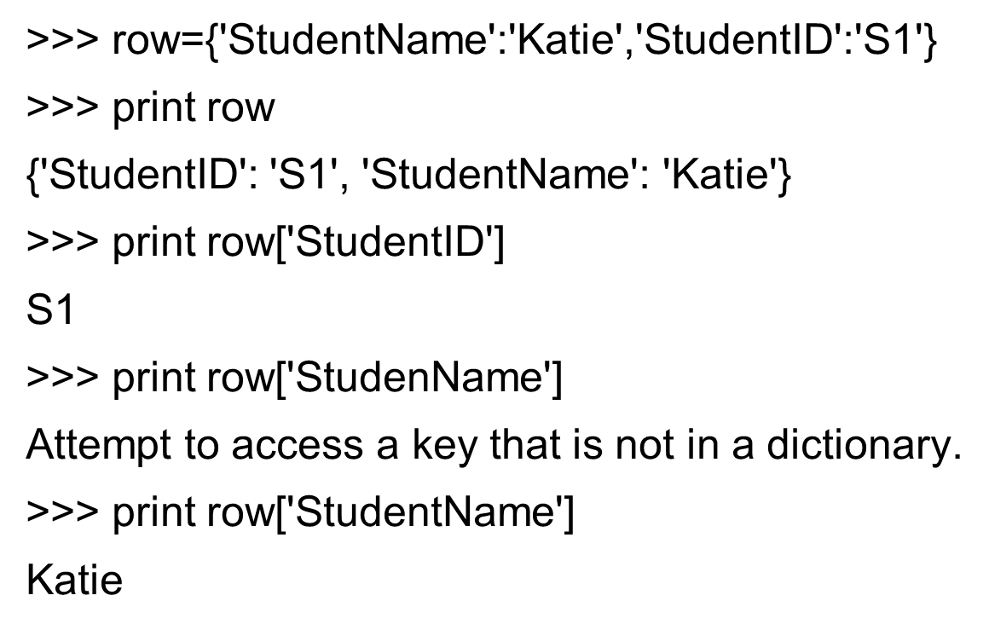
Hash Tables in Python

Slide 72
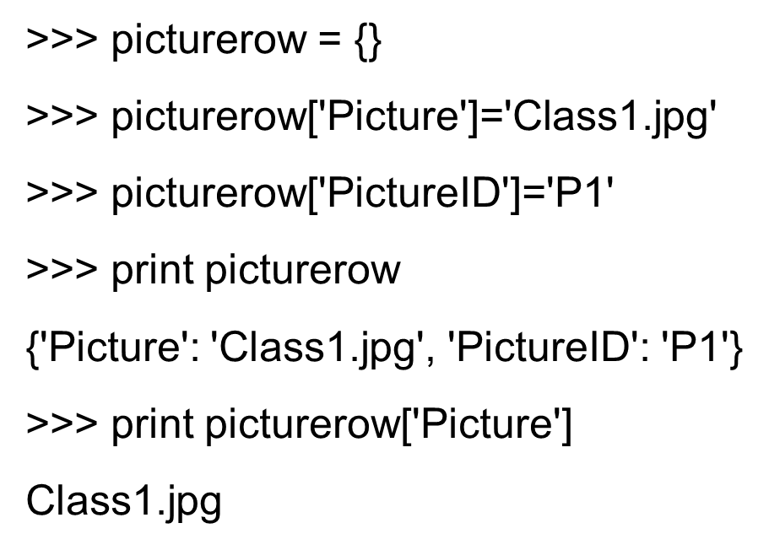
Building a Hash Table More Slowly

Slide 73
Building Relational Database out of Shelves of Hash Tables
For each row of the table, we can use a hash table.
We can store collections of rows in the same database.
We search for something by using a for loop on the keys() of the database

Slide 74
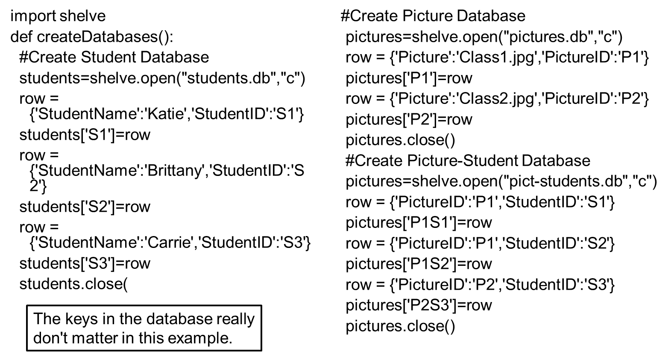
Creating a Database

Slide 75
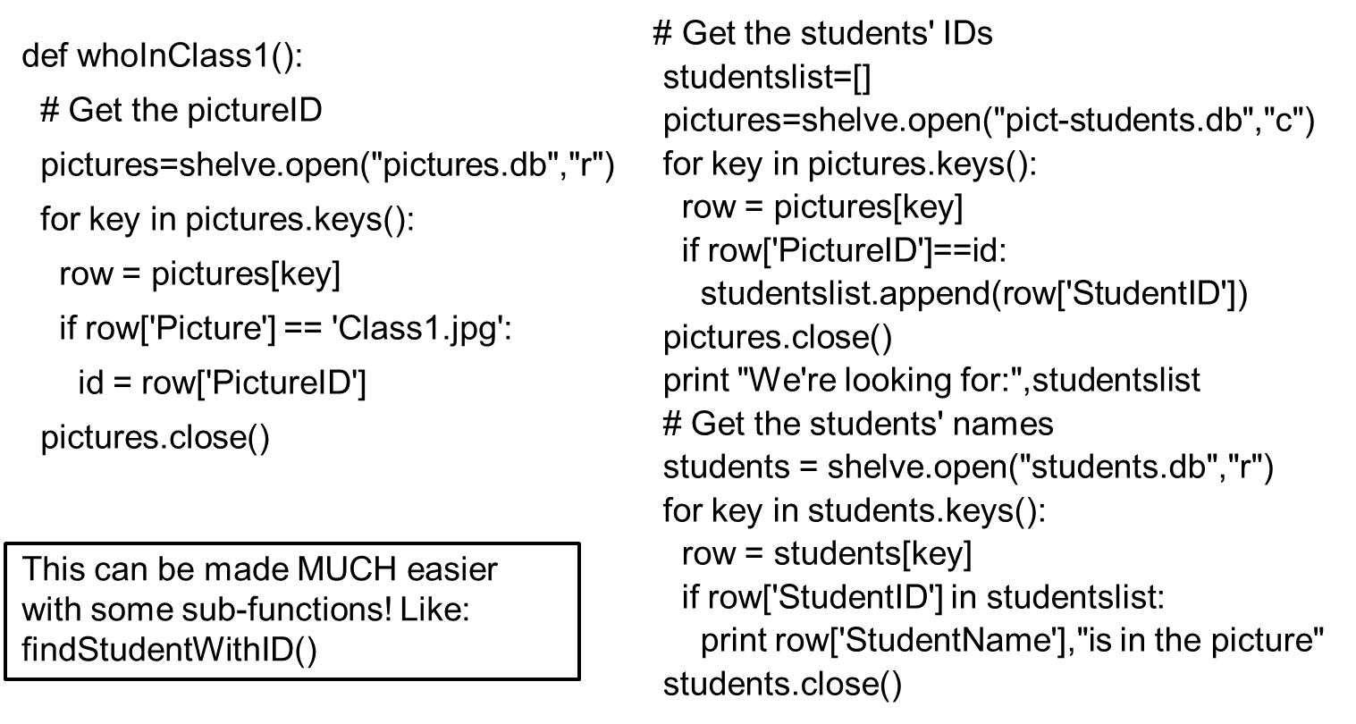
Doing a Join: Who is in Class1.Jpg?

Slide 76
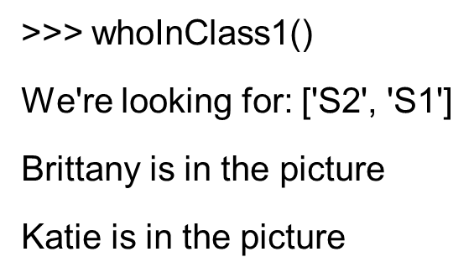
Running the Join

Slide 77
An Example Using My S Q L
We’re going to use an example using My S Q L
My S Q L is a popular open source database that runs on many platforms.
It’s powerful and can handle large, complex table manipulations.
The goal is not for you to learn to use My S Q L.
Very similar things can be done with Microsoft Access, SimpleD B/InstantD B, Oracle, Informix.
Just using My S Q L as an example.

Slide 78
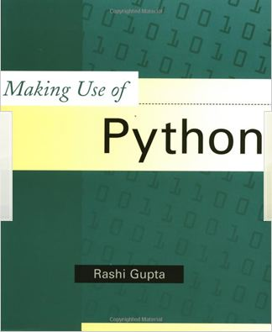

For More Information on Databases and S Q L in Python (and Jython)
Making Use of Python by Rashi Gupta (Wiley: 2002)
Python Programming with the Java Class Libraries by Richard Hightower (Addison-Wesley: 2003)
Notes:
Key point: What we're talking about here is not just for JES, or even just for Jython. You can do this in any Python implementation anywhere.
Key point: What we're talking about here is not just for JES, or even just for Jython. You can do this in any Python implementation anywhere.

Slide 79
Warning: We’re Going to Get Detailed and Technical Here!
If we ask you to do any database work on assignment, it will only be with anydbm and shelve.
However, if you do any database work in your professional life, you will be using relational databases and S Q L.
We won’t be asking you to do that for homework in this class.
The next few slides give you the pointers on how to set up My S Q L on your own computer.
But it’s not for the faint of heart!
If you’d like to avoid technical details, ignore the next Four slides

Slide 80
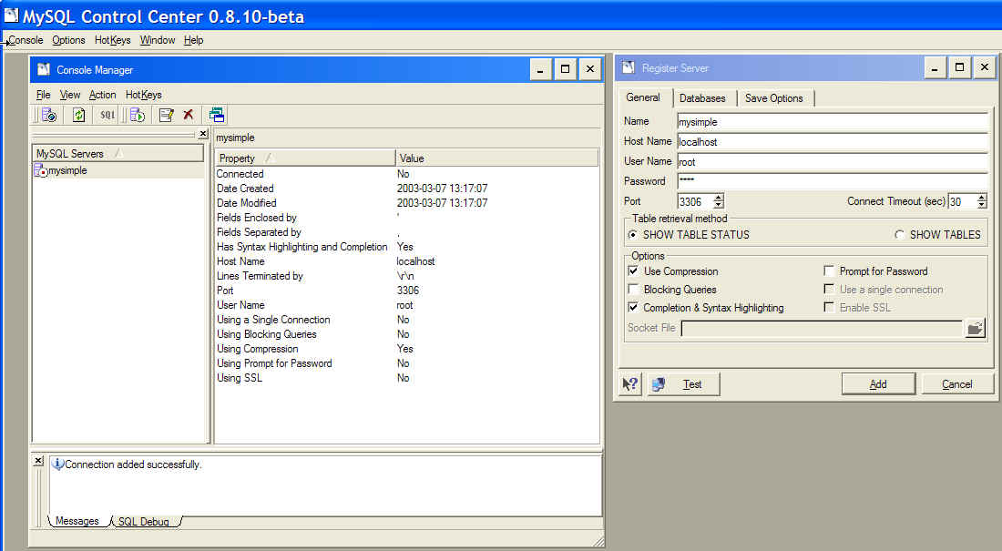
Installing My S Q L
Go to http://www.mysql.com/downloads/index.html
Download and install my S Q L
Suggestion: Download and install my S Q Lcc (Command Center)
Run the Command Center to create a connection
Automatically also creates a database connection named “Test”
Run “Mysqld” to get My S Q L running (in the background)

Slide 81
Getting Python to Talk to My S Q L
You have to modify your J E S to work with My S Q L
anydbm and shelve are built into J E S, but not the My S Q L connection
Download the My S Q L connection for Java from the My S Q L web site.
Place the .jar file that you download in your J E S \ jython “Lib” folder

Slide 82
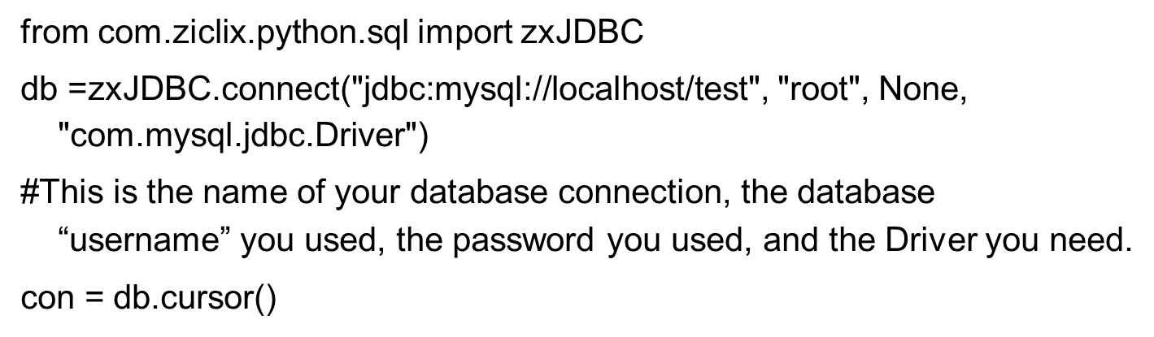
Setting up the Database Connection
The following is how you do it in Jython to talk to My S Q L.
Talking to Python is different only for this slide. The rest is the same.

Slide 83
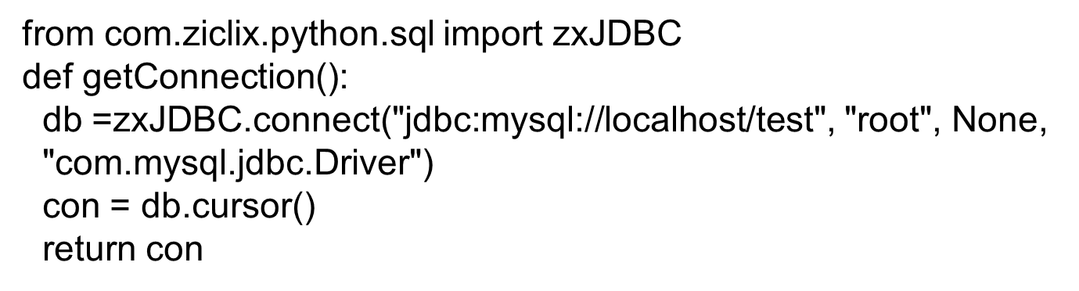
Put It in a Function
All these details are hard to remember, so hide it all in a function and just say con = getConnection()

Slide 84
Executing S Q L Commands (Back to the Generally Relevant Lecture)
Once you have a database connection (called a cursor in S Q L), you can start executing commands in your database using the execute method, e.g.

Slide 85
S Q L: Structured Query Language
S Q L is usually pronounced “S.Q.L.” or “Sequel”
It’s a language for database creation and manipulation.
Yes, a whole new language, like Python or Java
It actually has several parts, such as D D L (Data Definition Language) and D M L (Data Manipulation Language), but we’re not going to cover each part.
We’re not going to cover all of S Q L
There’s a lot there
And what’s there depends, on part, on the database you’re using.

Slide 86
Creating Tables in S Q L
Create table tablename (columnname datatype,…)
Tablename is the name you want to use for the table
Columnname is what you want to call that field of information.
Datatype is what kind of data you’re going to store there.
Examples: NUMERIC, INT, FLOAT, DATE, TIME, YEAR, VARCHAR(number-of-bytes), TEXT
We can define some columns as index fields, and then create an index based on those fields, which speeds access.
Notes:
Numeric is a general number. By specifying the kind of the number, SQL can be more efficient with memory or execution speed.
Varchar is up to a maximum size.
Text is any size.
Numeric is a general number. By specifying the kind of the number, SQL can be more efficient with memory or execution speed.
Varchar is up to a maximum size.
Text is any size.

Slide 87
Inserting Data Via S Q L
Insert into tablename values (columvalue1, columnvalue2…)
For our Person table:
Here’s where those two kinds of quotes comes in handy!

Slide 88
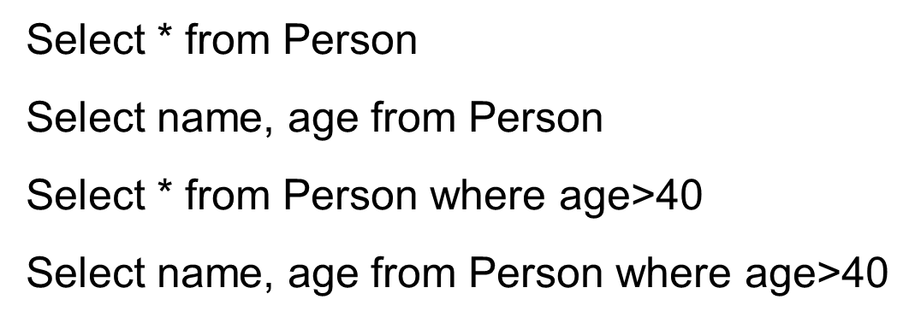
Selecting Data in a Database
Select column1, column2 from tablename
Select column1, column2 from tablename where condition

Slide 89
Doing This from Python
When you use a select from Python,
Your cursor has a variable rowcount that tells you how many rows were selected.
This is called an instance variable
It’s a variable known just to that object, similar to how a method is a function known just to that object.
Method
gives you the next selected row.
returns a list

Slide 90
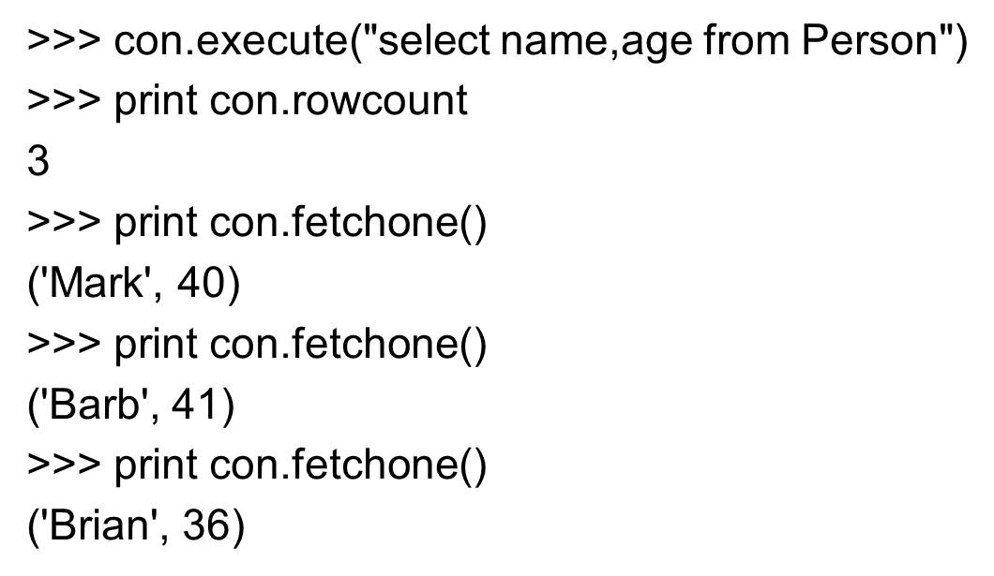
Selecting from the Command Area

Slide 91
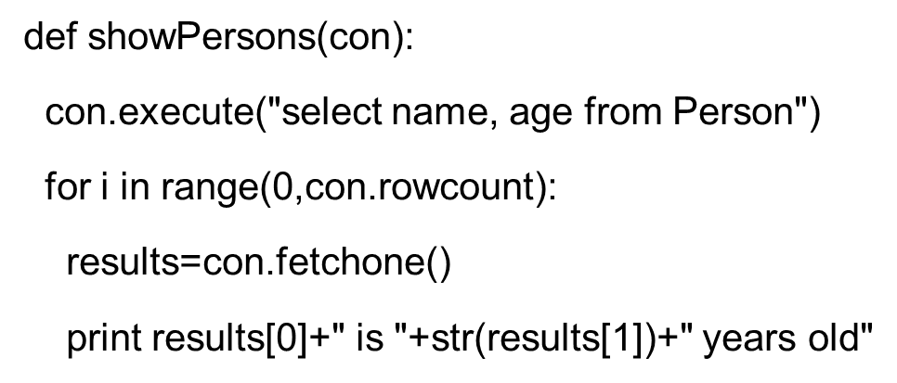
Selecting and Printing from a Function

Slide 92

Running Our Selection Function

Slide 93

Selecting and Printing with a Condition

Slide 94

Running the Conditional Show

Slide 95
The Point of the Conditional Show
Why are we doing the conditional show?
First, to show that we can have tests on our queries which makes processing easier.
Second, because this is how we’re going to generate H T M L: By assembling pieces as strings.

Slide 96

We Can Do Joins, Too (but More Complicated)
Answering: What picture is Brittany in?
StudentName | StudentID
Katie | S1
Brittany | S2
Carrie | S3
Picture | PictureID
Class1.jpg | P1
Class2.jpg | P2
PictureID | StudentID
P1 | S1
P1 | S2
P2 | S3

Slide 97

Copyright

